Slide 1



Spectral Forest
Benjamin Reed, Hayden O'Reilly, Manolo Ortiz

Slide 2
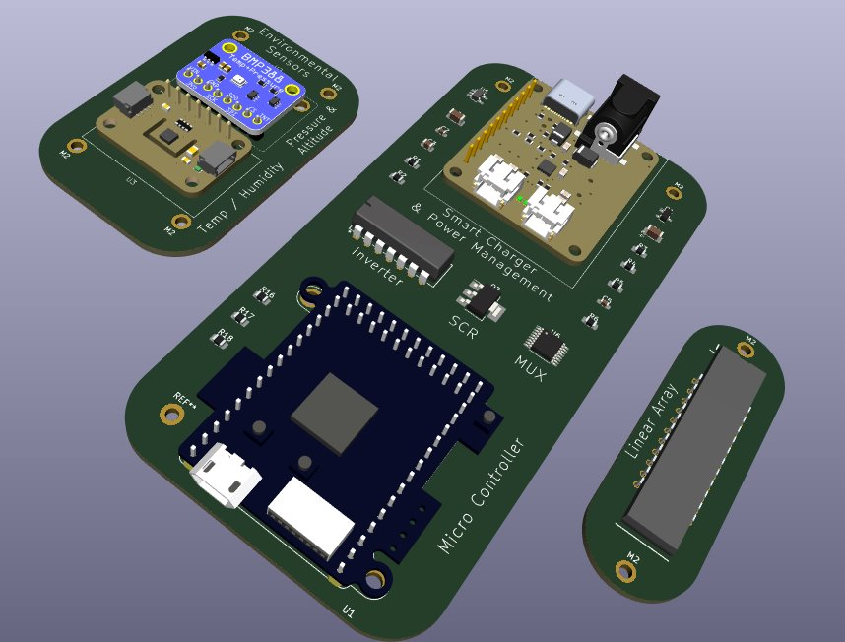
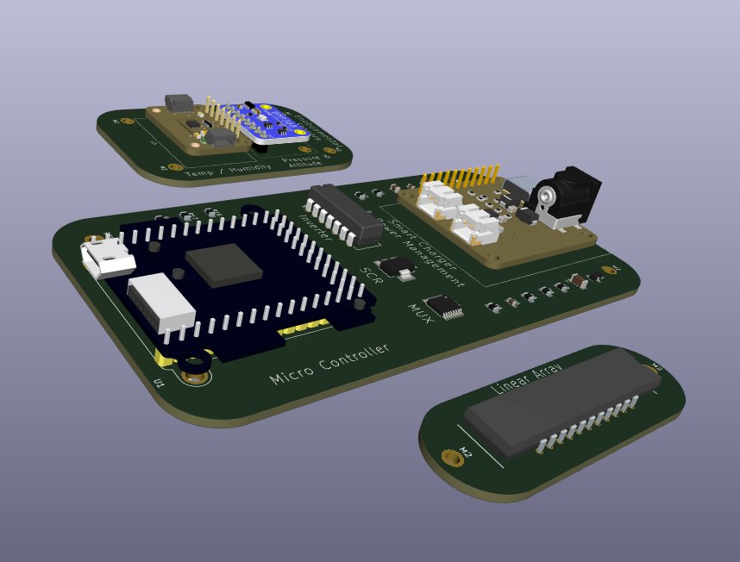
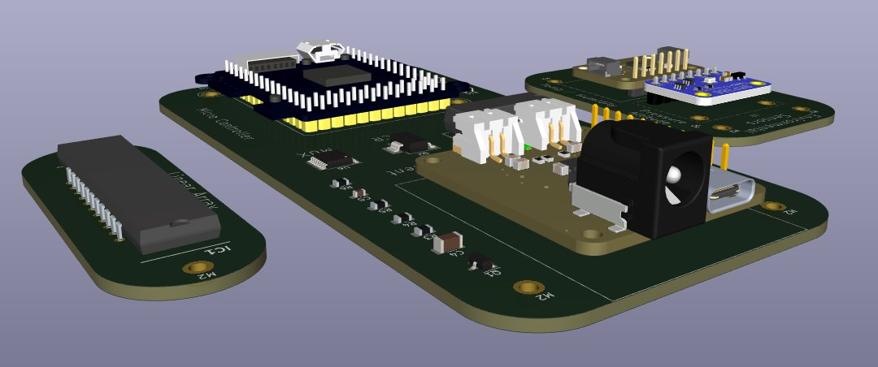
Introduction
>>> Traditional methods of measuring forest health can be cumbersome, time-consuming, and require significant labor.
>>> Calibrated Spectrometer allows for easy and remote data collection and storage; utilized to determine the condition of plants and trees.
>>> Implements a low-power, high-accuracy design with a custom PCB and automatic data storage.

Slide 3
Schematics

Slide 4


Coding
>>> MicroPython
>>> Created 25 different functions/definitions
>>> More than 700 lines of code
>>> GitHub for revision control
This Photo by Unknown Author is licensed under CC BY

Slide 5
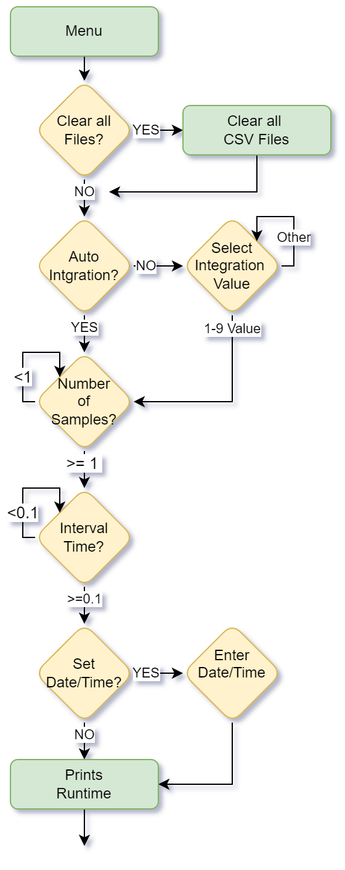
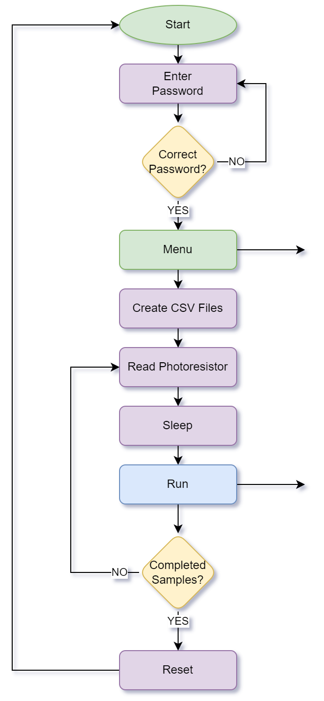
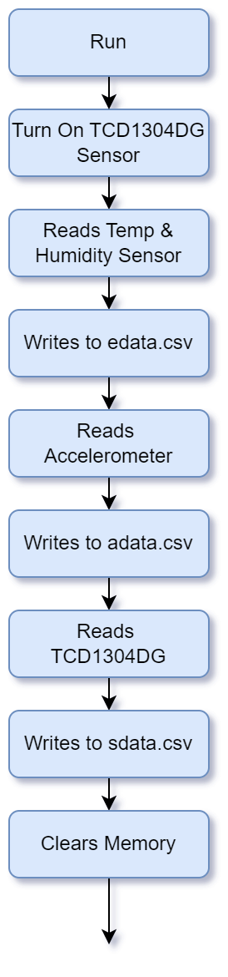
Code Flow Chart

Slide 6
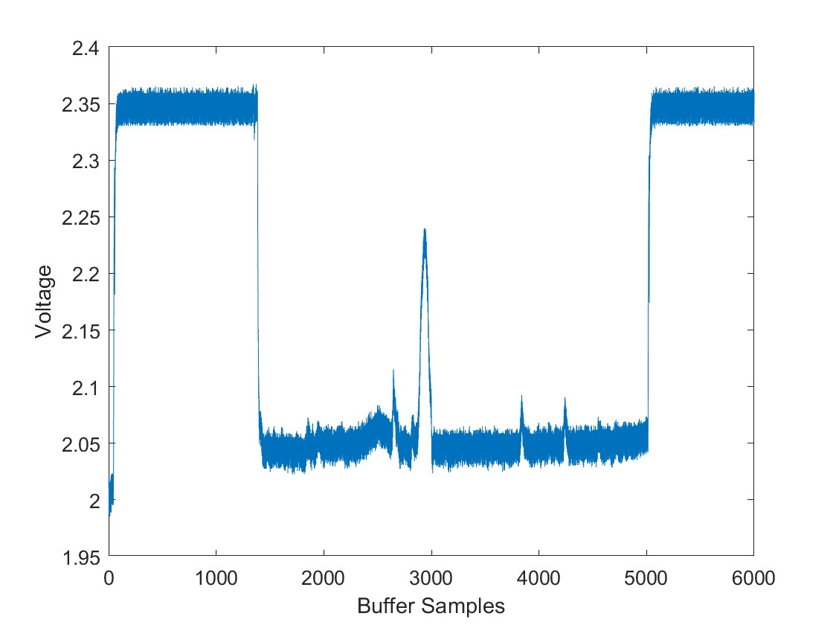
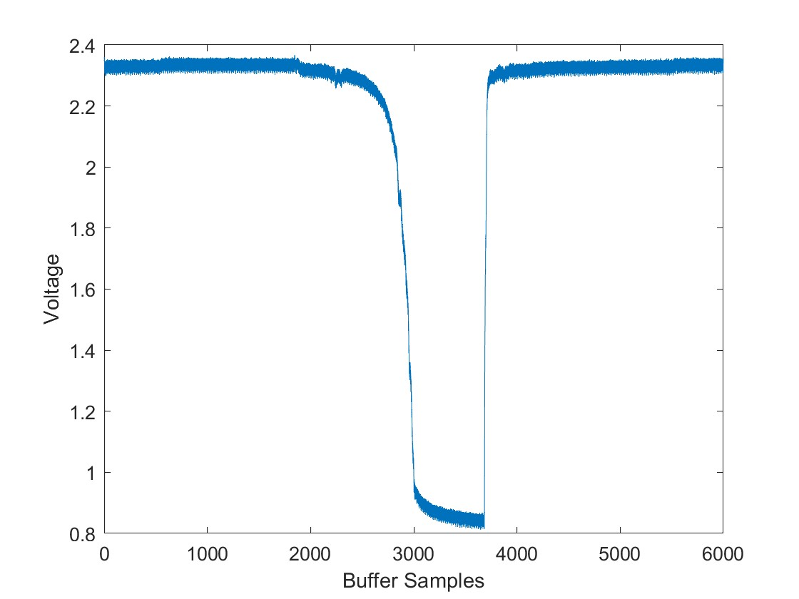
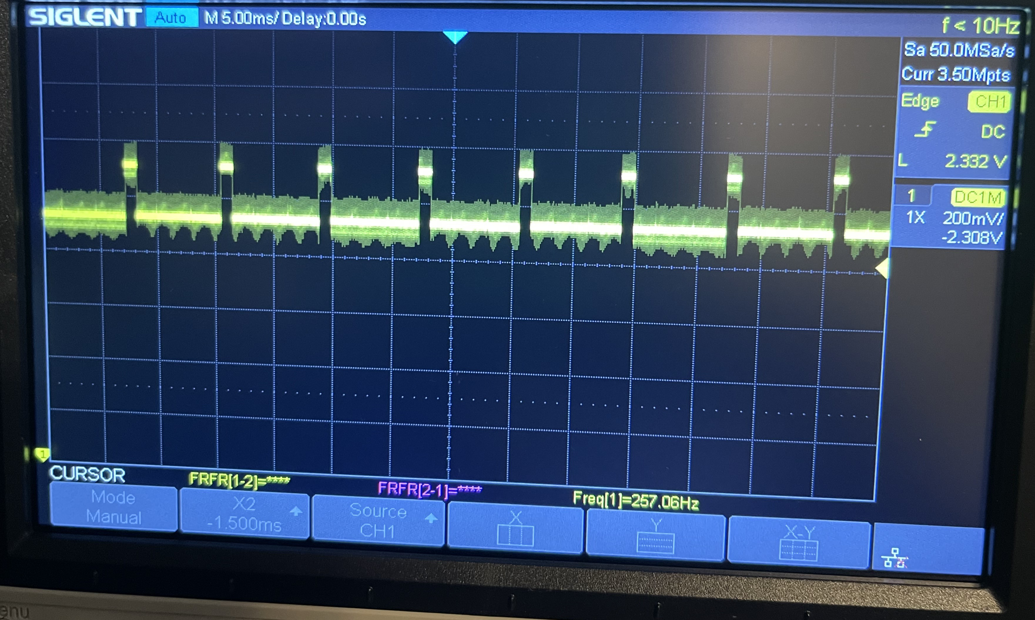
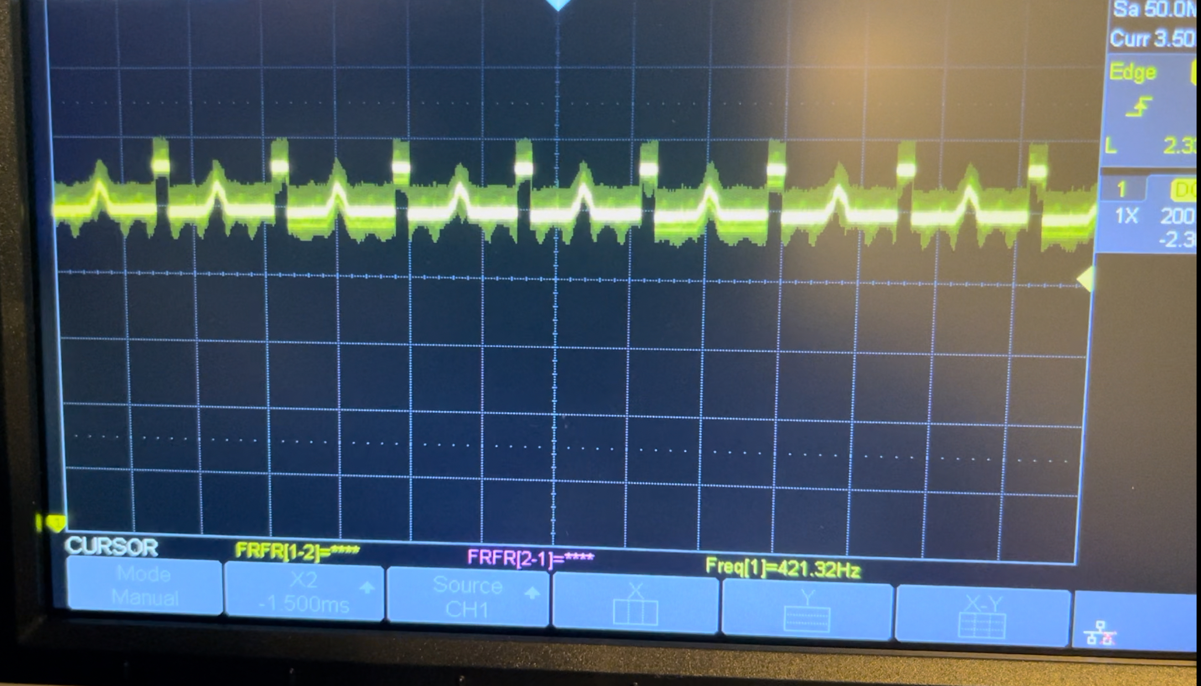
Results
400-1000 nm Wavelength
>>> Output signal from the sensor
>>> Output signal from the sensor reading a peak
>>> Data captured in a .csv file stored on the device

Slide 7
Conclusion
>>> Spectrometer successfully records/graphs data, dynamically stores data, and can run off multiple power sources at a low power level. Can auto-tune integration and is situated for Wi-Fi usage.
>>> Custom PCB and final code currently being optimized.
>>> In situ physical testing required for future optimizations of physical assembly and calibration.

Slide 8
Thank you

